Slide 1
Edited Pictures

Slide 2
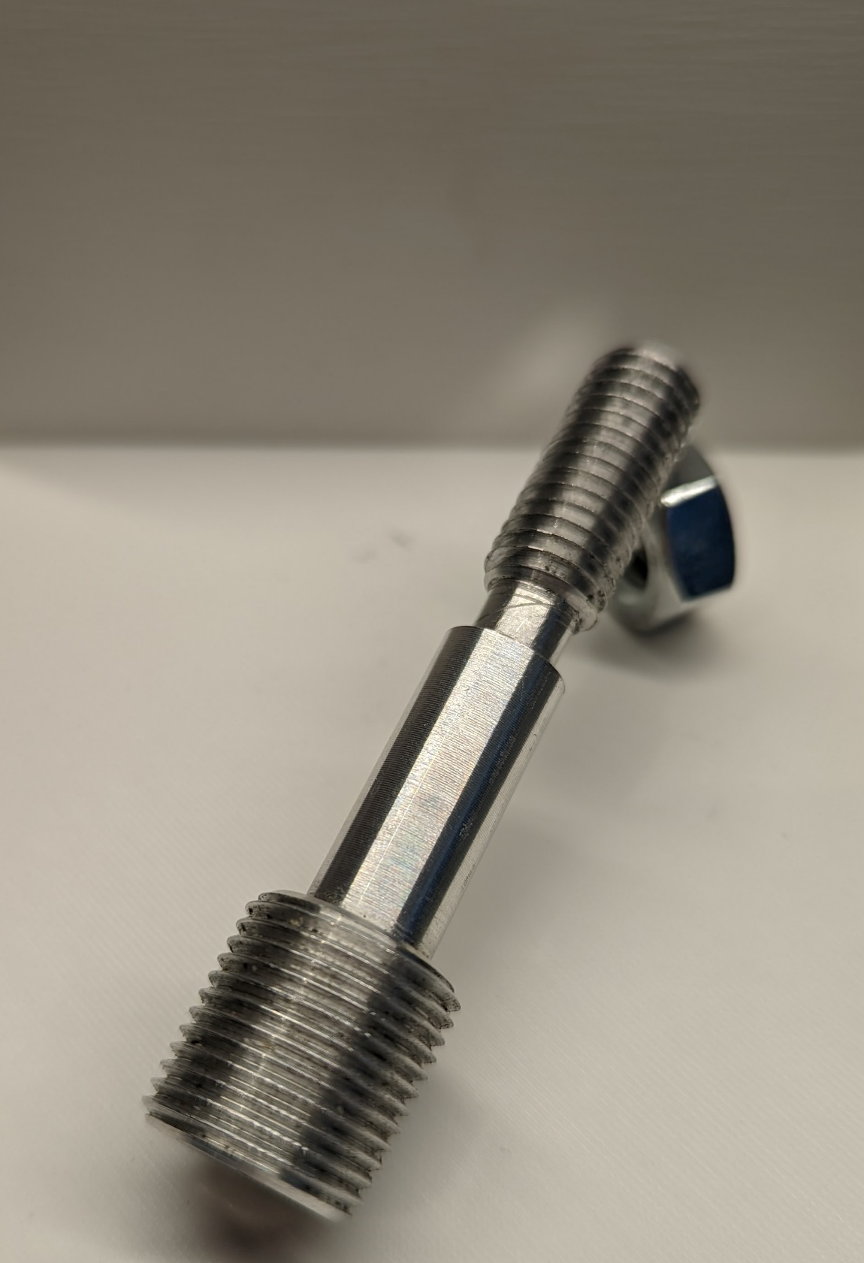
Title

Slide 3
V Model complete
Requirements
Mil
Qualification
Logical Architecture
HiL
Integration Test
System Test
System Design
Sil
Component Test
Component
Design
Implementation

Slide 4
V Model Requirements
Requirements
Mil
Qualification
Logical Architecture
HiL
Integration Test
System Test
System Design
Sil
Component Test
Component
Design
Implementation

Slide 5
Logical Architecture
Encoder
µ Controller
HMI
Mode (Inch/Metric)
Spindle Position
Translation [mm/Turn]
Motor Controller
Desired Position
Motor
Motor Voltage
Gear Box
Motor Position
Leadscrew Position

Slide 6
V Model System Design
Requirements
Mil
Qualification
Logical Architecture
HiL
Integration Test
System Test
System Design
Sil
Component Test
Component
Design
Implementation

Slide 7
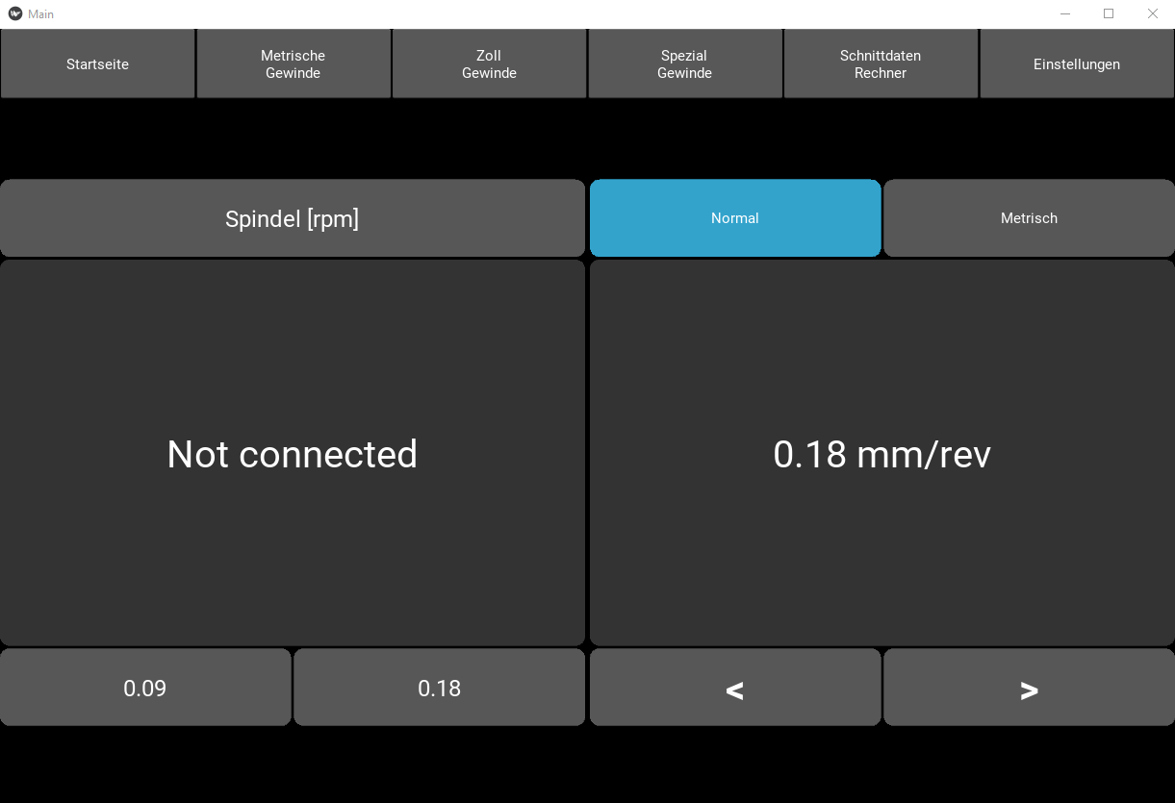
HMI
8
4
5
1
2
3
6
7

Slide 8
Micro Controller Blockdia
Calculate desired steps
Create Motor Pulses
Steps
Spindel Steps
Step Backlog
Dir

Slide 9
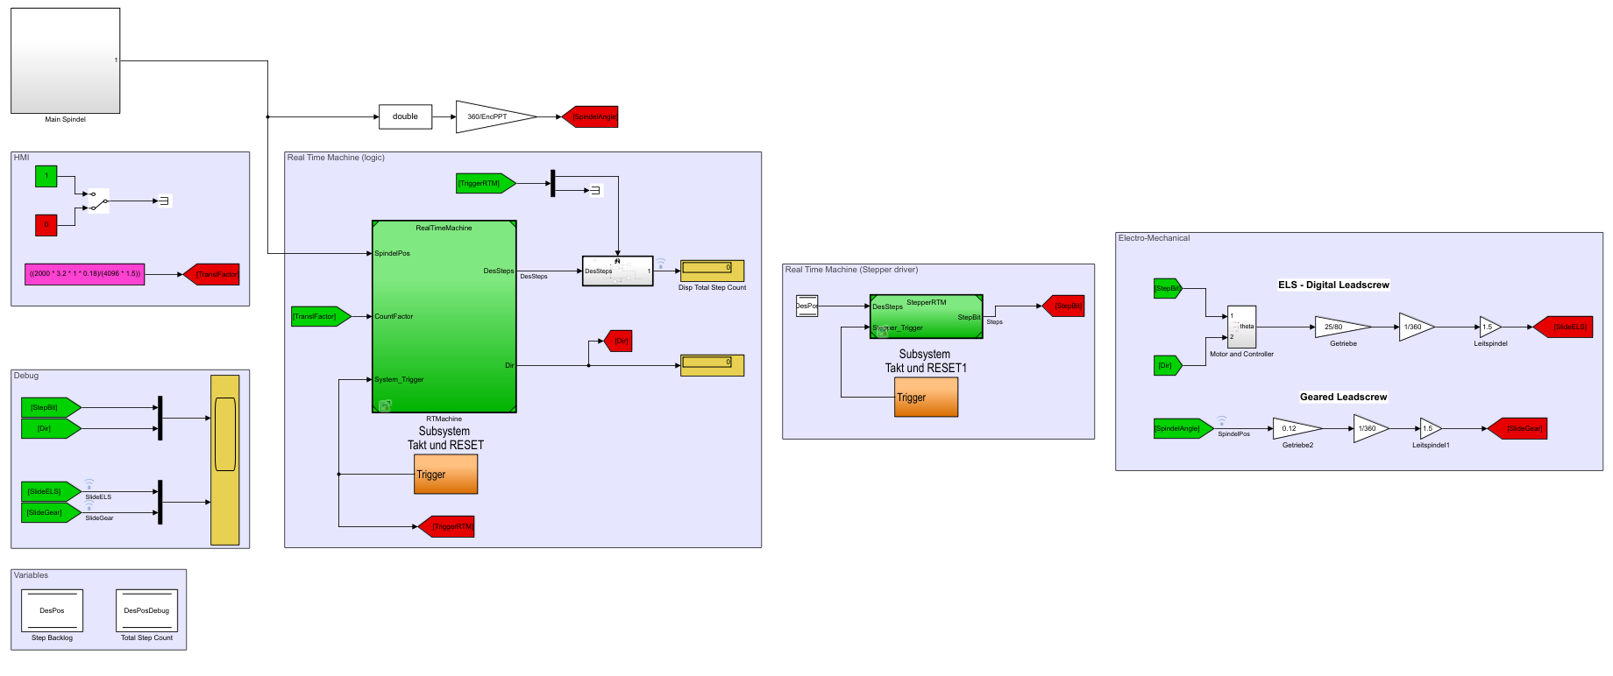
Simulink Modell
1
3
5
4
2

Slide 10
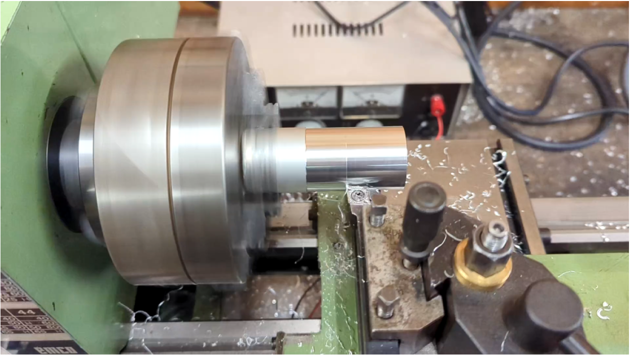
System design
Spindle Position
Transmission
Mode (Inch/Metric)
Encoder
µ Controller
HMI
Spindle RPM
System Status
Desired Position
Direction
Motor Controller
Motor
Position
Torque
Gear Box
Leadscrew Position

Slide 11
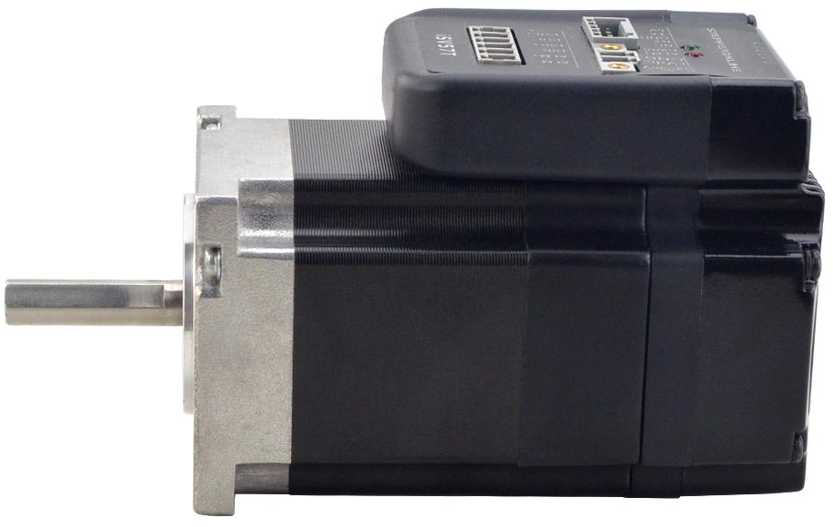
Integrated Servo motor
3
1
2

Slide 12
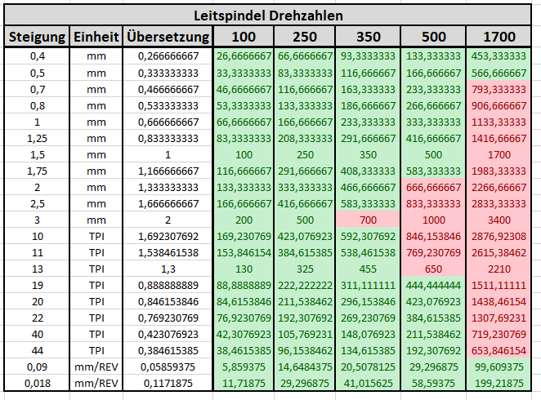
Gearbox

Slide 13
Software Implementation uC
1
Encoder Register
2
Desired Steps Register
Encoder Steps
Change?
Desired Steps > 0?
Overflow?
Underflow?
Step Bit High
-
Absolute Steps
Wait 1 µs
Right Turn?
Dir Bit !
Left Turn?
Step Bit Low
Calc
Desired Steps

Slide 14
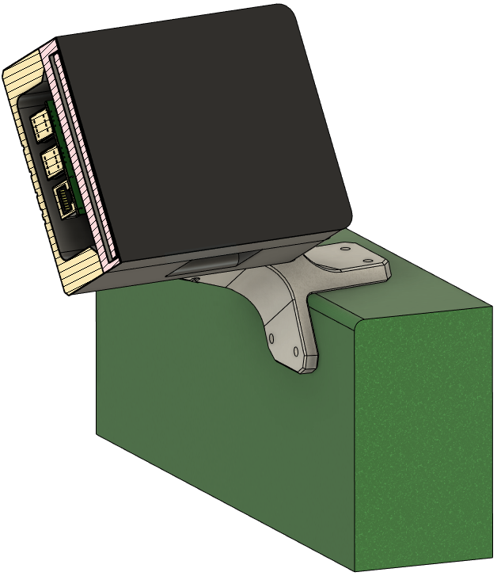
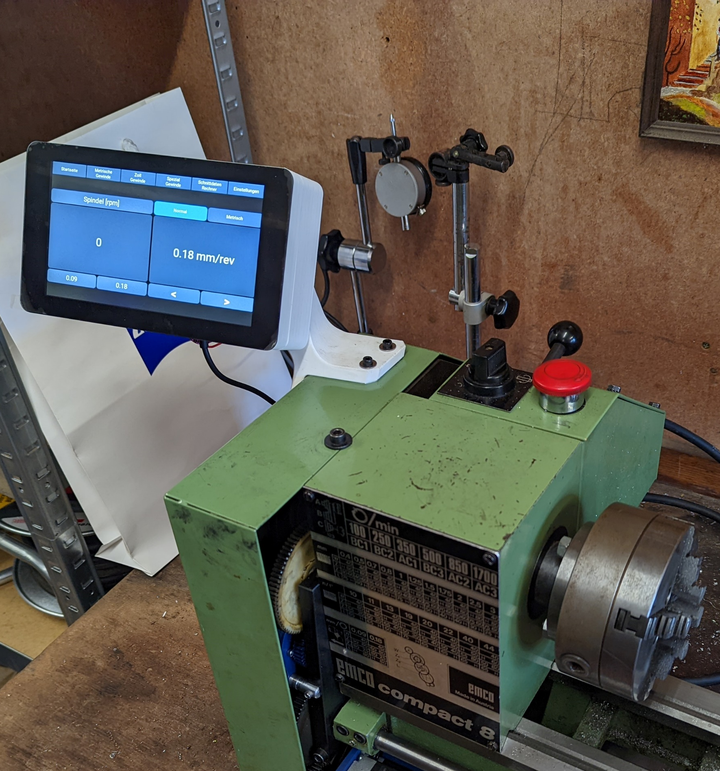
Implementation Touchscreen
5
1
2
3
4

Slide 15
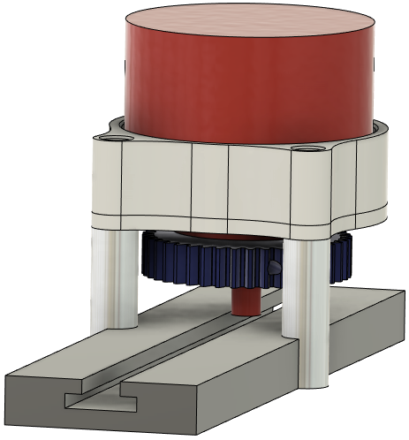
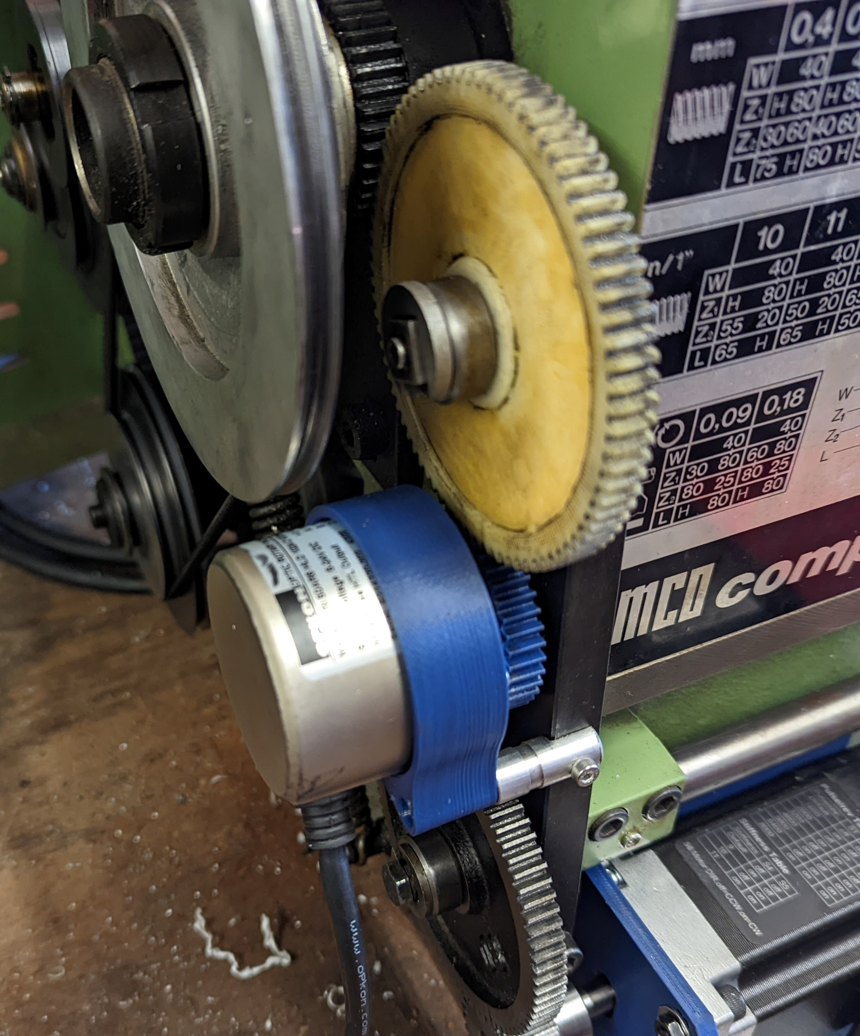
Implementation Encoder
6
4
3
5
2
1

Slide 16
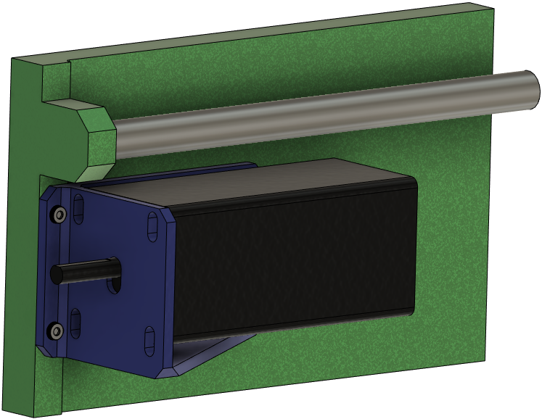
Implementation Motor
4
2
3
1

Slide 17
V Model Component Test
Requirements
Mil
Qualification
Logical Architecture
HiL
Integration Test
System Test
System Design
Sil
Component Test
Component
Design
Implementation

Slide 18
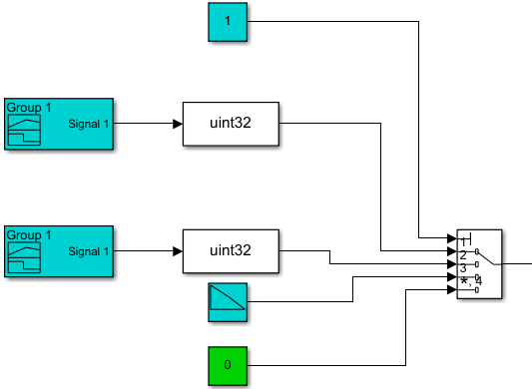
System Encoder
1
2
3
4
5

Slide 19
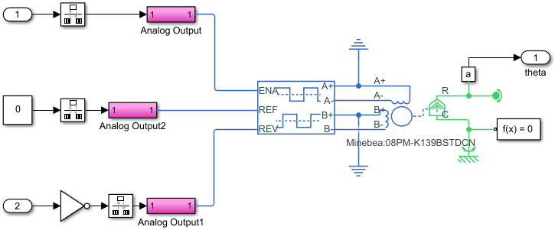
E Drivetrain
1
2
3
4

